Slide 1
Leverage 5G PaaS Cloud Native Edge Cloud with KubeEdge

Slide 2
5G Edge Cloud Development Trend
Multi-access edge computing:
Local traffic distribution: provides edge IaaS and PaaS services, such as video AI, CDN, and VR.
Edge cloud:
OTT cooperates with carriers to provide software and hardware integration MEC and edge-cloud synergy： AWS wavelength/Azure Edge Zone/Google GMEC
Fully distributed cloud:
GSMA OP/5G Future Forum proposes multi-path interconnection between carriers and edge clouds.

Slide 3
Challenges to be Solved while Apps move to 5G Edge Cloud

Slide 4

Developer: Enrich Apps with Network Features Integration and not only Pure Connectivity
Cloud gaming/AR/VR
V2X
MEC1
MEC2
MEC1
MEC2
Scenario:
While 2 gamers play together, it require to navigate two gamers to the right MEC which provide best QoS
MEC Capabilities:
Application roaming, QoS assurance and optimization, and elastic scaling
Scenario:
Autonomous driving car require agile cross carrier access to ensure service continuity
MEC Capabilities:
Application roaming and QoS guarantee
Edge services need to be deeply integrated with 5G network features, enable network synergy and being agile on deployment.

Slide 5
Developer: Require a Robust Platform to Accelerate Development and Management
Application layer
Scenario:
How application could easily consume network capabilities?
How developer could consume public cloud like rich contents middleware to accelerate development and management?
Gaming
V2X
AI
AR
QoS
Blockchain
certifying
Location
DB
Authorize
RNI
ServiceMesh
LoadBalancer
......
......
......
Require a development platform which expose resource in API in order to reduce development complexity.
Network capability
Middleware
API Gateway
Capability exposure layer
RAN/UPF
5GC/NEF
MEC
Resource layer

Slide 6






Operator：Difficult to Manage Distributed and Heterogeneous Edge sites
1. Edge nodes are widely distributed in different locations on the network. How to efficiently manage edge node?
Home
ACC
AGG
Metro
Enterprise
-50km
1-5ms
50-200km
5-10ms
>200km
>20ms
eNodeB
Onsite/Access edge
City edge
Provincial edge
Cloud Center
Edge
MEC
MEC
MEC
Cloud
Services
Cloud Services
Hundreds-Thousands
Tens-Hundreds
Tens
<10
2. Diversified applications have high requirements on heterogeneous computing and scalable resource. How to efficiently manage and flexibly configure heterogeneous resources?
Application
V2X, AR/VR, AI inference
AI inference and ARM
vCDN, AR/VR
Rendering and video transcoding
AI training, big data and unified management
AI training/inference, video transcoding
Computing

Slide 7
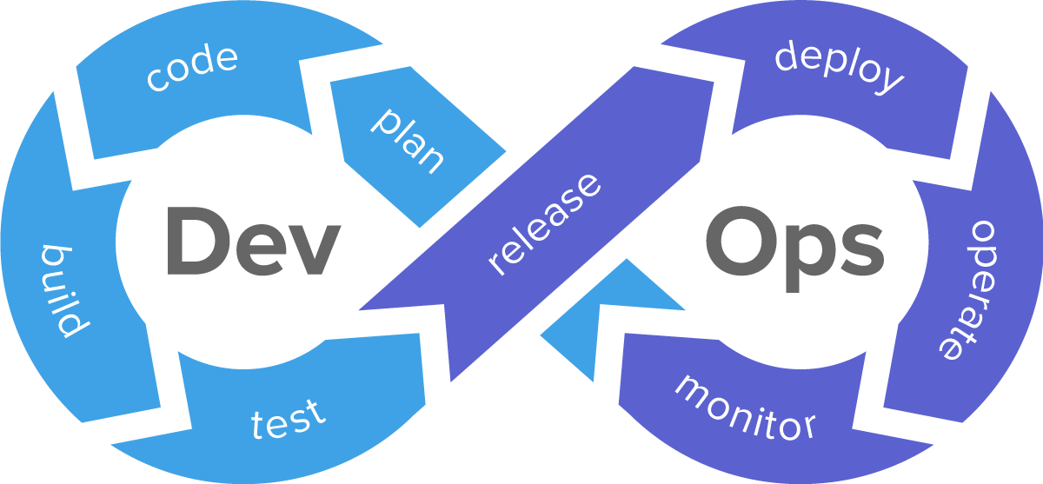
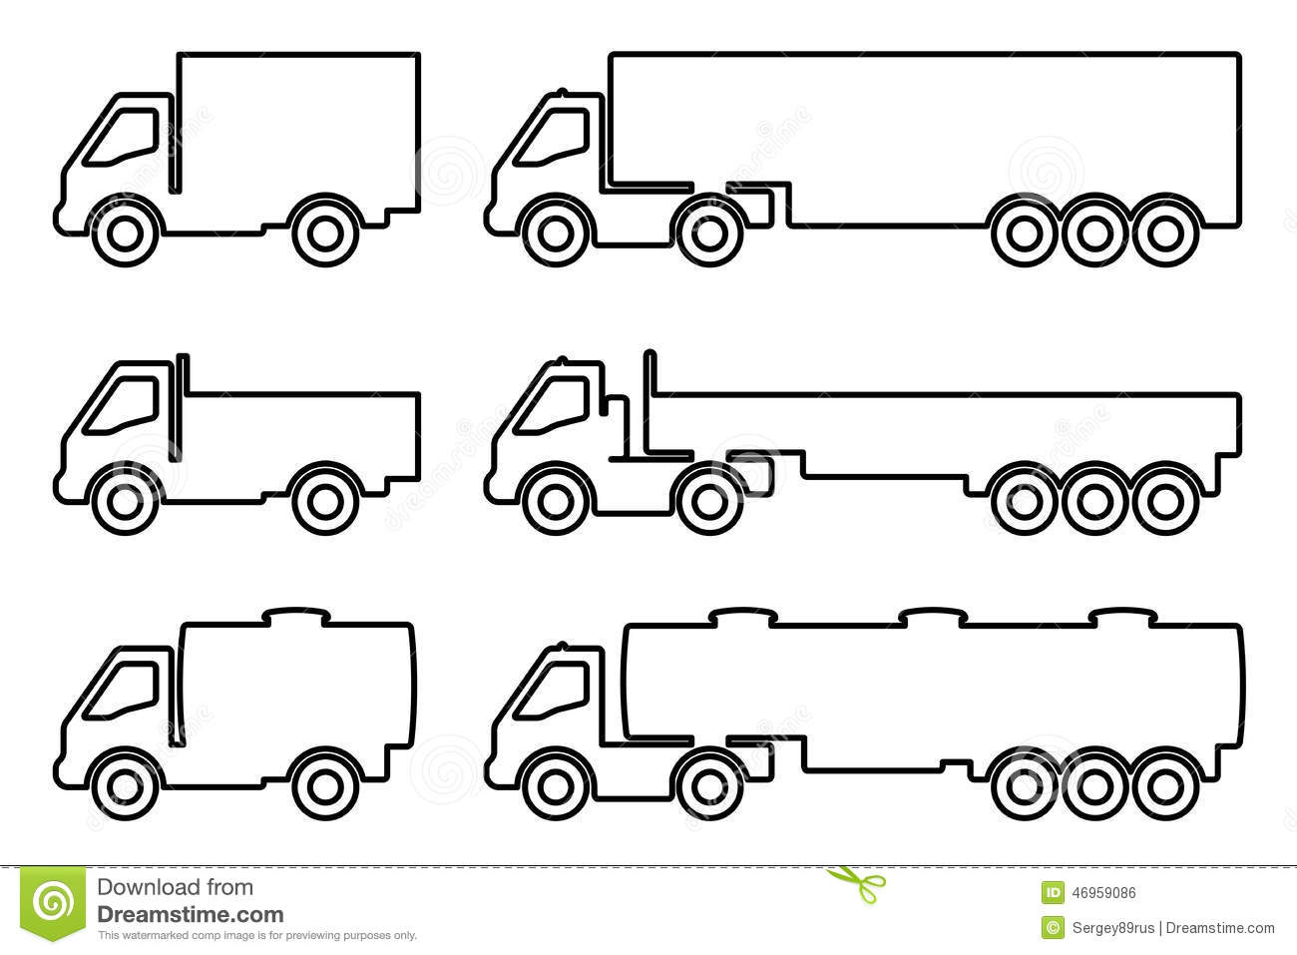
Summary: 5G Edge Require More Capabilities to Make It Become Scalable Business
Operator:
Require to manage and maintain a large number of distributed and heterogeneous edge sites
Developer:
Require to enrich apps with network capabilities.
Developer:
Require a robust platform to reduce development complexity
Massive scale
Heterogeneous hardware
Limited resources
Difficult O&M
Automatic DR
...
Global scheduling
Traffic delegation
Mobility management
Cloud-edge synergy
Application roaming
...
Network capability openness
Third-party capability openness
Unified API
Cloud ecosystem integration
Difficult application deployment
...
Autonomous driving
Video AI
VR/MR
Developer
Device
Easy deployment and O&M
Cloud-network convergence
Capability openness

Slide 8
Open Discussion
What is the role for edge computing in 5G 2B Business?
What is the Key Challenge for the development of 5G edge business?
What others thing we can do in order to fertilize MEC Ecosystem?

Slide 9
Open Source Intelligent Edge Project KubeEdge

Slide 10
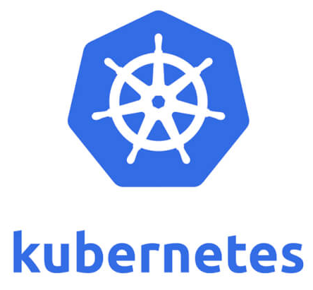




KubeEdge, a lightweight cloud-native intelligent edge platform
Smart Campus
Smart City
Smart Transport
Industry 4.0
...
Formal CNCF project (incubation), which is being used by 20+ companies
Kubernetes-based, 100% compatible, declarative APIs, CRD, customized controller, and strong scalability
Cloud-edge consistent container and Kubernetes ecosystem, application portability, build once, run anywhere
Edge-cloud synergy extends cloud capabilities to the edge, including AI collaboration, data collaboration, application collaboration, and management collaboration.
Cloud-edge communication ensures high-speed, reliable, and secure communication between cloud-edge devices.
Easy maintenance, lightweight, plug-in edge framework, offline autonomy, and automatic DR
Heterogeneous hardware is supported and decoupled from hardware.
Public/Private/Telco
Cloud Center
IoT applications
AI application
Big data
......
Application Lifecycle Management
Unified monitoring and O&M
KubeEdge
CloudCore
Edge Node Management
Edge-cloud communication
Internet/Direct Connect/VPN
IoT
Edge AI
Edge timing DB
Edge flow calculation
......
Node management
Container management
Monitoring and O&M
Edge-cloud communication
Security authentication
EdgeCore
Lightweight container engine
X86
GPU

Slide 11
Centralized management of massive edge sites, improving O&M efficiency
Easy deployment and maintenance
Key capabilities:
Multi-cloud management: Centrally configures and manages edge resources in different locations, improving deployment and O&M efficiency
Multi-cluster scheduling, automatic autoscaling and disaster recovery of applications between clusters
Edge-cloud message channel optimization, reducing edge-cloud network bandwidth consumption and avoiding network congestion in large-scale scenarios
Edge autonomy: When an edge node is faulty, applications are automatically scheduled in the edge cluster, quickly migrated, and recovered in seconds.
Global Manager & Scheduler & Config
Cluster 1
Cluster N
Cluster N
K8s master
K8s master
K8s master
…
CloudCore
CloudCore
CloudCore
Teleco cloud
Public cloud
message channel
message channel
message channel
APP
APP
APP
EdgeCore
EdgeCore
EdgeCore
MEP
MEP
Edge Cloud
Onsite/Access edge
Municipal core/aggregation edge
region

Slide 12

Cross-edge cloud traffic management, simplify application development and ensures application stability
Easy deployment and maintenance
Key capabilities:
Unified microservice management, cross-edge microservice discovery and mutual access, improving microservice development efficiency, agile development, and fast iteration
Traffic management between edge- edge and edge-cloud, providing governance capabilities such as traffic routing, traffic limiting, and circuit breaker, improving service system stability
Continuous online, edge gray release, and typical release processes such as canary and blue-green release, reducing service downtime
Cloud
Public cloud VPC
Cloud node
KubeEdge
Istio
SVC1
Pod
Pod
Envoy
Envoy
Service container
Service container
Edge private network
Edge private network
Edge node
Edge node
Edge node
Edge node
EdgeMesh
EdgeMesh
EdgeMesh
EdgeMesh
DNS
Proxy/LB
/...
HTTP, TCP, ...
DNS
Proxy/LB
/...
HTTP, TCP, ...
DNS
Proxy/LB
/...
HTTP, TCP, ...
DNS
Proxy/LB
/...
HTTP, TCP, ...
SVC3
SVC2
Pod
Pod
Pod
Pod

Slide 13









Cloud-network convergence
All-domain dynamic scheduling, QoS guarantee, nearby access, and on-demand acceleration
Key capabilities:
Multi-edge resource collaboration: Detects resource capacities of multiple edge nodes and dynamically decide app deployment locations based on load and subscriber distribution.
Edge scheduling to commit QoS: the networks hierarchy are formulated based on service characteristics, the QoS indicators (such as bandwidth, delay, and jitter). Automized provision of QoS hierarchy services, provide end-to-end network quality assurance.
Traffic nearby access: The access locations aterminals and edge devices are dynamically adjusted based on network quality to ensure the optimal access delay.
Multi-tenant resource sharing: Multi-tenant applications can share edge computing and network resources based on 5G traffic distribution.
Interactive live broadcast
CloudVR
Cloud gaming
Global scheduling
Global traffic management
KubeEdge
Edge Node Management
Interconnection with the 5GC NEF
CloudCore
Edge node
●
●
Edge Hub
Edge node
Codec
rendering
●
Edge Hub
●
●
●
rendering
rendering
Application A
Application B
Edge node
●
EdgeCore
Edge Hub
Application B
Application B
rendering
Codec
EdgeCore
Application B
Application A
EdgeCore

Slide 14
Cloud-network convergence
Actively Contribute in GSMA Operator Platform, enable Cross-carrier and cross-edge federation, achieving seamless application roaming
Portal (Resource, Application, Developer)
Network Function
GSMA Operator Platform definition:
NBI: Unified portal for deployment management. Developer sign up with one operator then they could enjoy service deployment in multiple platform from different telco
UNI: Service discovery and proper edge service selection
EWBI: Discovers capabilities of each OP and invokes other OPs to deploy applications, implementing carrier interconnection.
SBI: interconnects with carriers' MEC, cloud, and 5G networks.
NBI
OP1
KubeEdge
4
Others
Management Plane
1
2
Operator
Edge Service Discovery
Service Resource Manager
Service
Hub
OP2
UNI
EWBI
NEF
SBI-NR
SBI-CR
User App
K8S Master
EdgeMesh
kubeEdge focuses on the following features:
ESD: Cross-Edge Cloud Service Discovery and Nearby Access
SRM: Based on 5G network events and ESD, implement dynamic resource scheduling, elastic scaling, failover, seamless application roaming across edge clouds, and mobility management across clouds and carriers.
EdgeMesh: Cross-Edge Cloud L3/L7 Network Streamlining and Microservice Traffic Governance
NBI: Unified portal for deployment management. Only one OP can be deployed and applied to multiple carrier MECs.
CloudCore
Data Plane
3
EdgeMesh
EdgeMesh
User App
User App
UE
Service Broker
Service Broker
UPF
SDK
EdgeCore
EdgeCore
Infrastructure
Infrastructure
Operator MEC
OTT EdgeSite

Slide 15

Enable rapid innovation of 2B/2C services by Capability Openness Platform
Capability openness
Key Capabilities
Service Hub: Service and operator are released on the Hub to build an open edge application market.
Network Openness : expose network capabilities by unified, open and aggravated API platform
Service Broker : An API Gateway which provides API version management, authentication, and authorization
Secondary development SDKs: accelerate industry application integration. Assists network SLA monitoring and service discovery.
Supports various heterogeneous hardware and combinations to meet diversified service requirements.
Cloud
1
Kubernetes Master
Service Hub
AR/VR
Gaming
Video on-live
APP
Network Openness
2
QoS
Location information
......
UPF
3
UE
Service Broker
(Distributed API-G)
APP
Client
RAN
SDK
5
4
X86
GPU

Slide 16



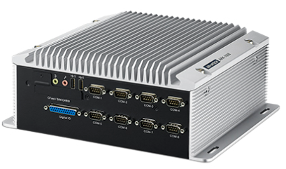




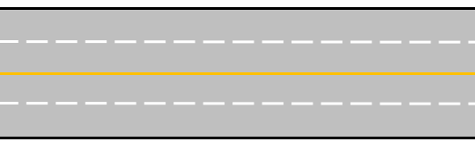
Reference: China Highway Toll System (ETC) Digital Transformation
Business Benefits
Efficiency 10x growth , 15s => 2s in avg. per car ; 29s => 3s in avg. per truck
Anti Fraud
Solution Highlight
Low latency: lightweight AI inference engine with local data processing
Heterogeneous devices: Heterogeneous hardware and OSs are supported.
Large scale: 100,000+ edge nodes are quickly accessed, and millions of applications are coordinated between the edge and cloud.
Unified management: unified management of application images, deployment, scheduling, O&M, and upgrade
Multiple role and hierarchy management(six levels): supports needs from different stakeholder: central management centers, provincial management centers, road management companies, road management company’s branches, and toll stations.
Manual Toll
Intelligent Toll
Traffic Management Center
*Vehicle Infra Cooperative
Video Cloud
O&M Center
Cloud
App Center
Algorithm Center
Kubernetes + KubeEdge
Edge Node
Edge Node
Edge Node
Toll Count
Toll Count
Toll Count
Edge
Car and plate recognition
Car and plate recognition
Car and plate recognition
Atlas 500
Atlas 500
3rd party Equipment
Challenge:
Low Efficiency – Car stuck at toll and create traffic jam
High OPEX – Human intensive job
Fraud – Drive use “bugs” to reduce payment, like change ticket, quick bypass together with others car
Terminal
Camera
RSU
RSU-D
RSU
RSU-D
Off Road Equipment

Slide 17
Collaboration Discussion

Slide 18

GSMA & ECC Jointly Establishing a Cross-Operator Interoperability Test Bed
Operator 1
Objectives:
Setup cross operator and cross edge interoperability lab, involve industrial player to test real business product
To solve cross-carrier and cross-edge cloud interconnection problems, implement seamless application roaming, and accelerate edge application ecosystem construction.
Benefits
Learn and share global best practice.
Find out end customer requirement in rea test
Ignite real business
Progress:
Agreed to participate: GSMA, Huawei, ECC, China Unicom, 5G Cloud Game Association
Inviting: CMCC, Orange, DT, ARM, Intel, Gameloft, CG163 etc
Operator 2
MEC
OTT
MEC
Application A
Application A
Application A
Application B
Application B
Application B
Fault-insensitive switchover
Seamless application roaming

Slide 19
Thanks

